Slide 1

CSM GP Workshop
14 December 2023

Slide 2

Introduction to SConstruct and Python

Slide 3
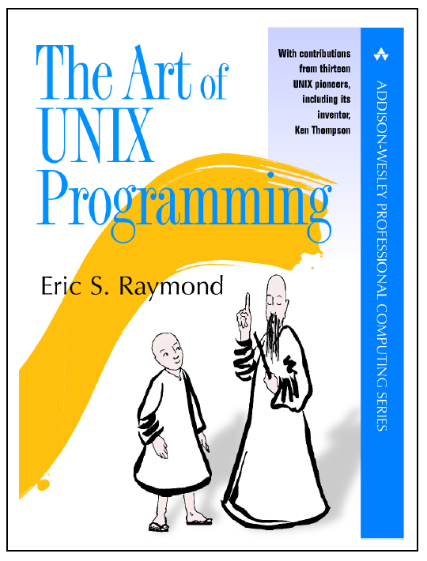
Madagascar Design Principle
Data arrays are file objects on disk
“Write programs that do one thing and do it well. Write programs to work together. Write programs to handle text streams, because that is a universal interface.”
- Doug McIlroy

Slide 4
“To design a perfect anti-Unix, make all file formats binary and opaque, and require heavyweight tools to read and edit them.”
“If you feel an urge to design a complex binary file format, or a complex binary application protocol, it is generally wise to lie down until the feeling passes.”
- Eric Raymond
Data
Data
Graphics
Data
Data
Graphics
Data
Filter
Filter
Data
Plot
Graphics
Filter
Filter
Plot
Filter
Filter
Plot

Slide 5
Outline
RSF file format
Introduction to SCons and Python
Putting it all together, SConstruct

Slide 6
RSF File Format
Header
file
Data
Self-describing data format
Header file
Data file
Supported data types
Uchar, char, short, int, float, complex, double
Supported data file formats
Native binary, XDR, ASCII
Can interface with other formats
SEPlib
SEGY
Seismic Unix (SU)

Slide 7
RSF format describes a Hypercube

Slide 8
RSF language interface
Can read and write RSF files with other languages
C
C++
Fortran
Python
Octave
Java
Matlab

Slide 9
Datapath determines where data file is put
datapath= parameter on the command line.
DATAPATH environmental variable
.datapath file in the current directory.
.datapath file in the user home directory.
Current directory
Data file may be appended to header

Slide 10
Outline
RSF file format
Introduction to SCons and Python
Putting it all together, SConstruct

Slide 11

What is SCons?
Build system (Software Construction)
Written in Python
Configuration files are Python scripts
Built-in support for different languages
Dependency analysis
Parallel builds
Cross-platform

Slide 12
Evolution of Build Systems
Make (1977)
“Sendmail and make are two well known programs that are pretty widely regarded as originally being debugged into existence. That's why their command languages are so poorly thought out and difficult to learn. It's not just you - everyone finds them troublesome.”
Peter van der Linden
GNU Make (1988)
SCons (2000)

Slide 13

What is Python?
Dynamically typed programming language
Clear, readable syntax
“friendly and easy to learn”
Full modularity
“batteries included”
Integrates with other languages
“plays well with others”
Free and open-source

Slide 14
Who uses Python?
“Python has been an important part of Google since the beginning and remains so as the system grows and evolves. Today dozens of Google engineers use Python, and we're looking for more people with skills in this language." Peter Norvig
“Python is fun, free, runs on a broad range of platforms and has a large library of sophisticated modules, including numerical. It meets all our criteria for a first language.” John Scales & Hans Ecke

Slide 15
Python in 6 Easy Steps
Variables and strings
Lists and dictionaries
For loop
If/else, indentation
Functions and modules
Multidimensional arrays

Slide 16
1. Variables and Strings
>>> a=‘Melbourne’
>>> a[0]
‘M’
>>> a[:3]
‘Mel’
>>> b = a + “ rocks”
>>> print b
‘Melbourne rocks’
>>> a+2
Traceback (most recent call last):
File “<stdin>”, line 1, module <module>
TypeError: cannot concatenate ‘str’ and ‘int’ objects
>>> a+str(2013)
‘Melbourne2013’

Slide 17
2. Lists and Dictionaries
>>> a = [‘Melbourne’, ‘ASEG’]
>>> a[0]
‘Melbourne’
>>> len(a)
9
>>> a.append(20)
>>> a
[‘Melbourne’,‘ASEG’,20]
>>> b = (‘Melbourne’,‘ASEG’)
>>> b.append(20)
Traceback (most recent call last):
File “<stdin>”, line 1, in <module>
AttributeError: ‘tuple’ has no attribute ‘append’
>>> c = {‘city’: ‘Melbourne’, ‘year’: 2013}

Slide 18
3. For loop
>>> a = (‘Melbourne’, ‘Perth’)
>>> for city in a:
… print city, len(city)
Melbourne 9
Perth 5
>>> for k in range(2):
… print k, a[k]
0 Melbourne
1 Perth
>>> c = {‘city’: ‘Perth’, ‘year’: 2015}
for key in c.keys():
… print c[key]
‘Perth’
2015

Slide 19
4. If/else, indentation
>>> for k in range(4):
>>> if k < 2:
… print k
… else:
… print ‘no’
0
1
no
no
>>> try:
… a = ‘Perth’ + 2015
except:
… print ‘error’
error

Slide 20
5. Functions and modules
>>> def add_5(a):
… ‘Add 5 to input’
… return 5+a
>>> a = add_5(3)
>>> a
8
>>> def add_b(a,b=5):
‘Add b to a’
… return b+a
>>> add_b(a)
13
>>> import math
>>> math.sqrt(add_b(a,8))
4

Slide 21
6. Multidimensional arrays
>>> import numpy
>>> arr=numpy.zeros((2,2), dtype=numpy.float32)
array([[ 0., 0.],
[ 0., 0.]])
>>> arr[0,1]=1.0;
array([[ 0., 1.],
[ 0., 0.]])
>>> arr.ravel()
array([ 0., 1., 0., 0.])
>>> arr*2+1
array([[ 1., 3.],
[ 1., 1.]])

Slide 22
Outline
RSF file format
Introduction to SCons and Python
Putting it all together, SConstruct

Slide 23
The problem with scripts for data processing…
Cheap
Fairly cheap operation
Execution flow
Computationally expensive operations
Cheap
Time for each component

Slide 24
Is that you have to run the entire script again if something goes wrong..
Cheap
Fairly cheap
Execution flow
Computationally expensive
Cheap
Time for each component

Slide 25
Storing the results at each step and resuming from the problem saves time
Cheap
Fairly cheap
Execution flow
Computationally expensive
Cheap
Time for each component

Slide 26
SConstruct for data processing
An SConstruct file is a Python script with functionality to construct causal dependencies between data processing blocks
Fetch( ‘filename’, ’dirname’ )
A rule for downloading files from a server
Flow( ‘target’, ‘source’, ‘command’ )
A rule for making target from source
Plot( ‘target’, ’source’, ‘command’ )
Like Flow but generates a figure file
Result( ‘target’, ‘source’, ‘command’ )
Like Plot but generates a final result

Slide 27
SConstruct for data processing
from rsf.proj import *
import sys
# Fetch a shot gather from the default Madagascar data server
Fetch('wz.35.H','wz')
# Convert the shot gather to native format and window it
Flow('shot_gather','wz.35.H','dd form=native | window n1=400 j1=2 | smooth rect1=3')
# Plot the data
Result('shot_gather','pow pow1=2 | grey')
# Example flows, note that sf is missing from program calls, this Flow generates "spikes.rsf"
Flow("spikes", None,'''spike nsp=3 n1=1000 k1=200,600,800 mag=1,-0.5,0.5''')

Slide 28
SConstruct for data processing
# sprayed.rsf is now the target of or causally related to the source spikes.rsf
Flow("sprayed","spikes",'''bandpass fhi=5 | spray axis=2 n=100''')
# This takes sprayed.rsf and puts a finalised plot in the Fig directory, note the pipe from bandpass to grey
Result("spray_plot","sprayed",'''bandpass fhi=5 | grey color=e title="Yes we can with SConstruct!" ''')
# This puts a plot in the current directory
Plot("spray_temp","sprayed",'''bandpass fhi=5 | grey color=e title="Yes we can with SConstruct!" ''')
# You can only print to standard error in SConstructs and Madagascar programs.
# Standard output and input is reserved for IO.
print >> sys.stderr, "Python code in the SConstruct is executed before Flows"
End()

Slide 29
Using SConstruct for program compilation
env=Environment()
env.Program(“program”, “file.c”)
scons –h # Print help message
scons –n # Dry run
scons –c # Clean the build
scons –Q # Suppress messages
scons –j # Build jobs in parallel

Slide 30
Parallel Processing with pscons
Figures out the number of nodes/CPUs and runs
scons –j
Use split= and reduce= to split data for data-parallel processing

Slide 31
Summary
RSF file format is simple, represents a multidimensional array as text + binary
Madagascar programs are building blocks, can run on the command line and pipe Unix-style
SCons is a powerful and convenient build system adopted by Madagascar for data processing and reproducible documents
Configuration files are Python scripts

Slide 32
CSM GP Workshop
14 December 2023

